Slide 1
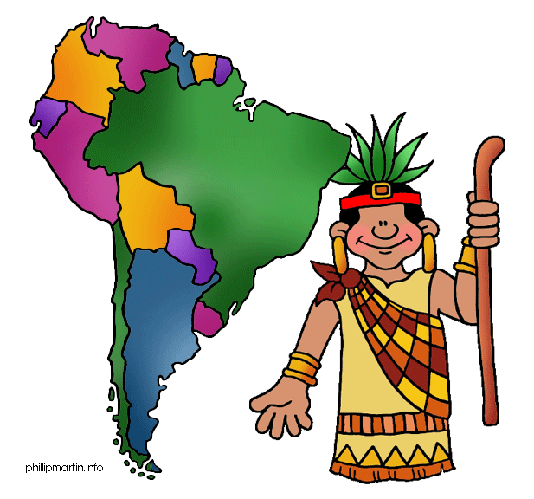
ALP
B01

Slide 2


Option 1:
Time: 5 to 10 minutes.
Groups of 4 people.
Talk about one country, describe the cities, the people, the attractions, tourist places, etc. Using the vocabulary and grammar from the book.
Use materials and a powerpoint
presentation

Slide 3
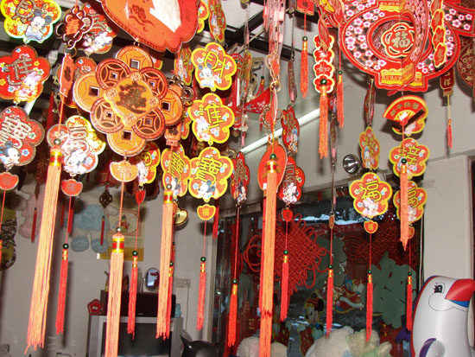
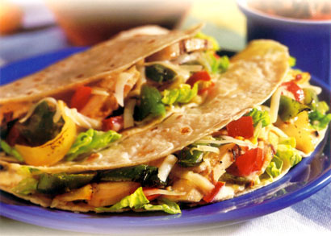

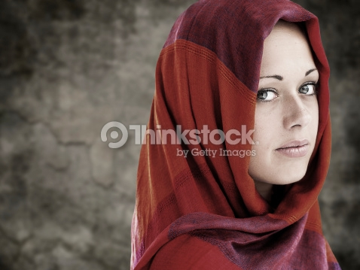

Ideas for the project:
Decoration
Images of food
Objects
Clothes
Flag

Slide 4
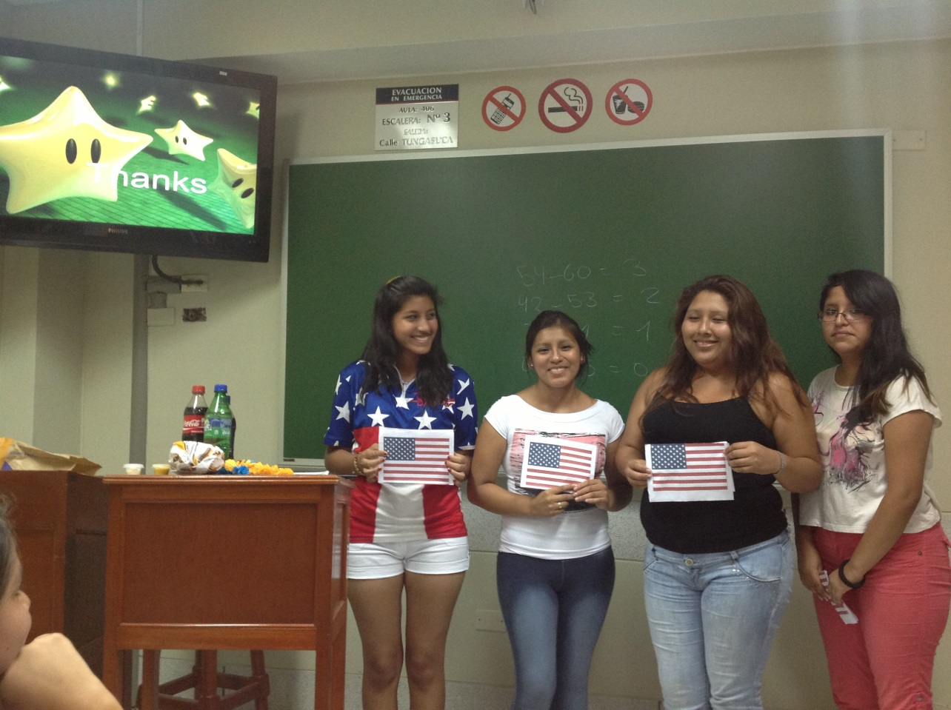
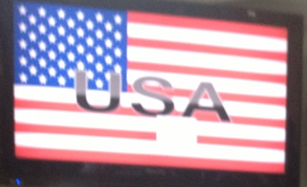
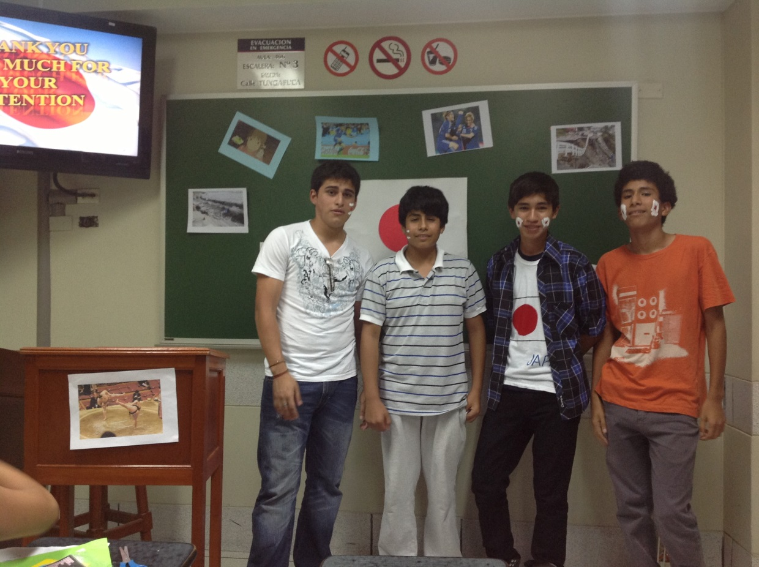
USA
JAPAN

Slide 5
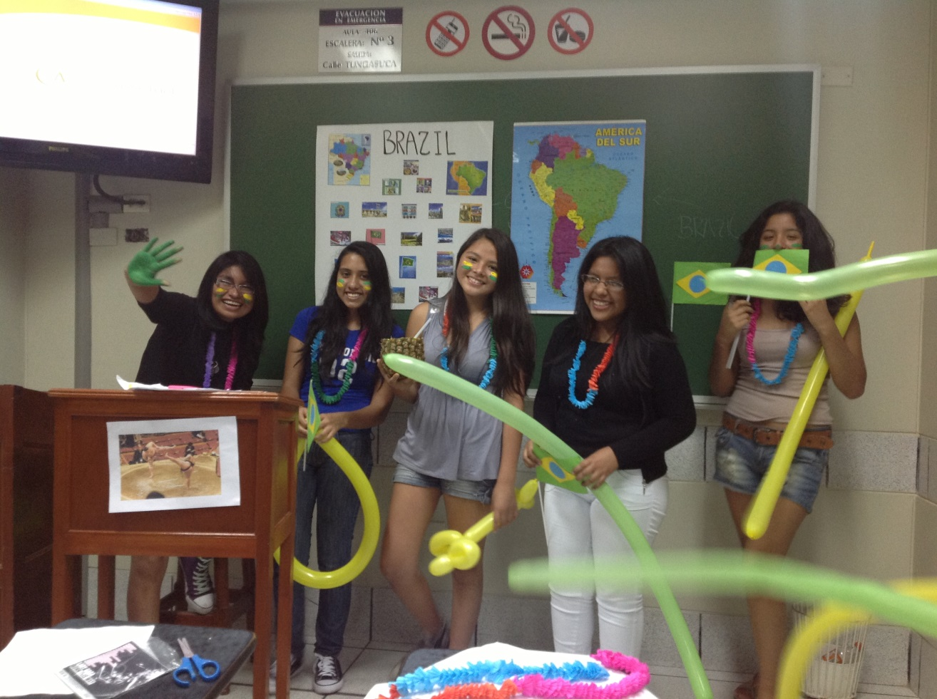
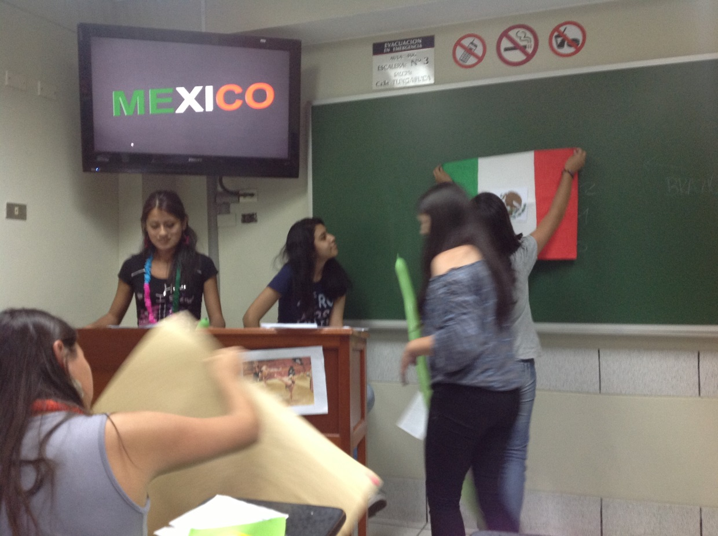
BRAZIL
MEXICO

Slide 6
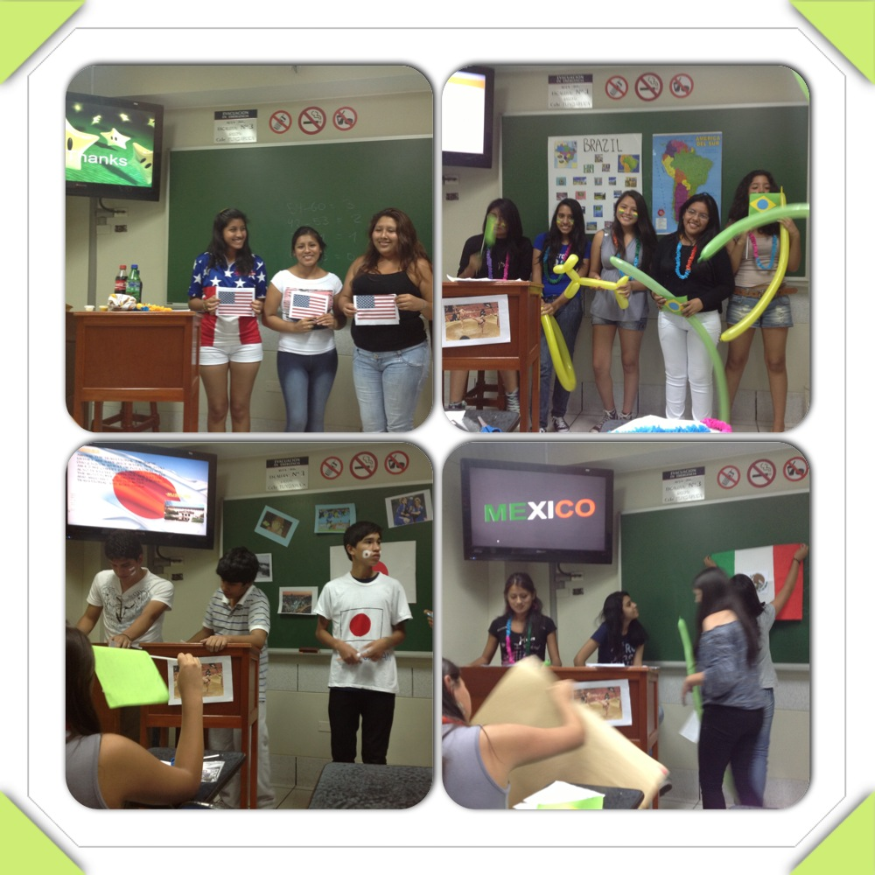

Slide 7
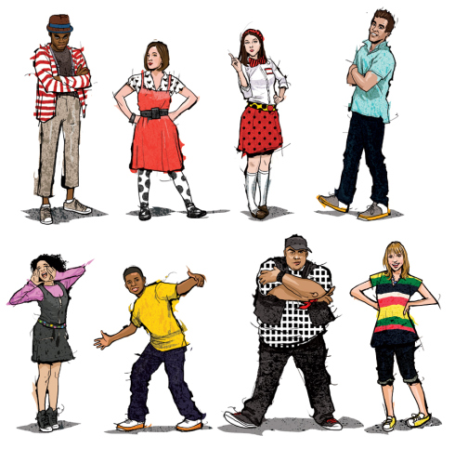
Option 2:
Individual or in pairs
Talk about two people (one male and one female)
Talk about their personal information, interests, favorites, country, city, nationality, etc. Using the vocabulary and grammar from the book
Make a poster with pictures.

Slide 8

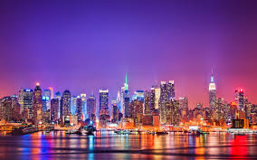
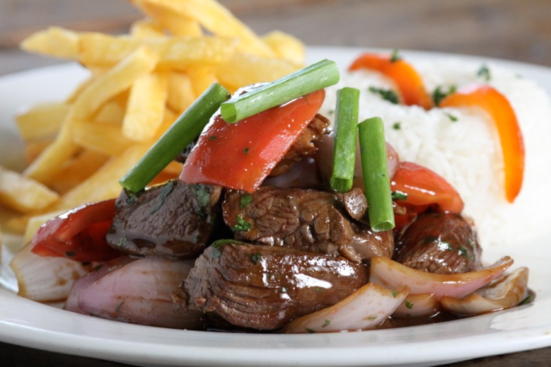

Ideas for the project:
City
Country
Favorite Sport
Favorite Food
TV show

Slide 9
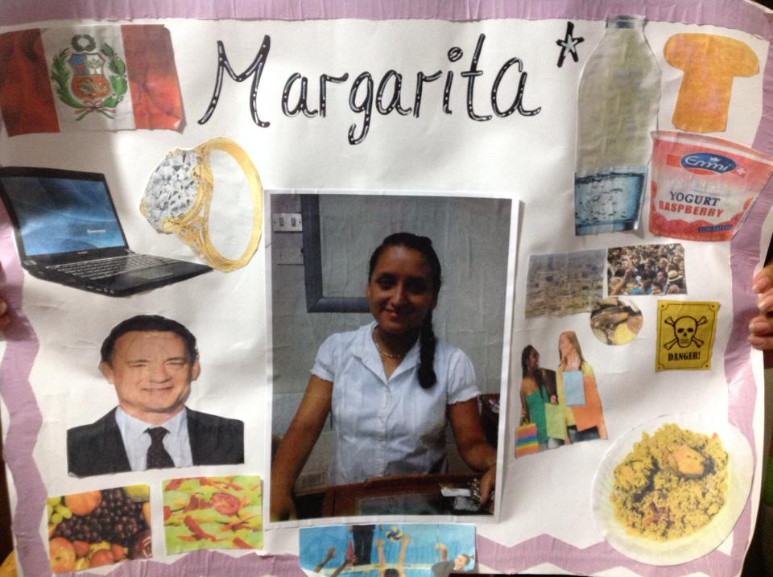
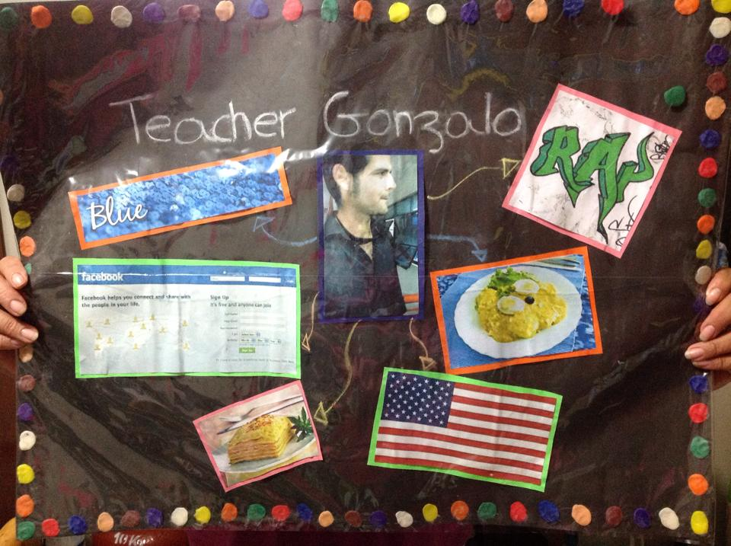

Slide 10
